Slide 1
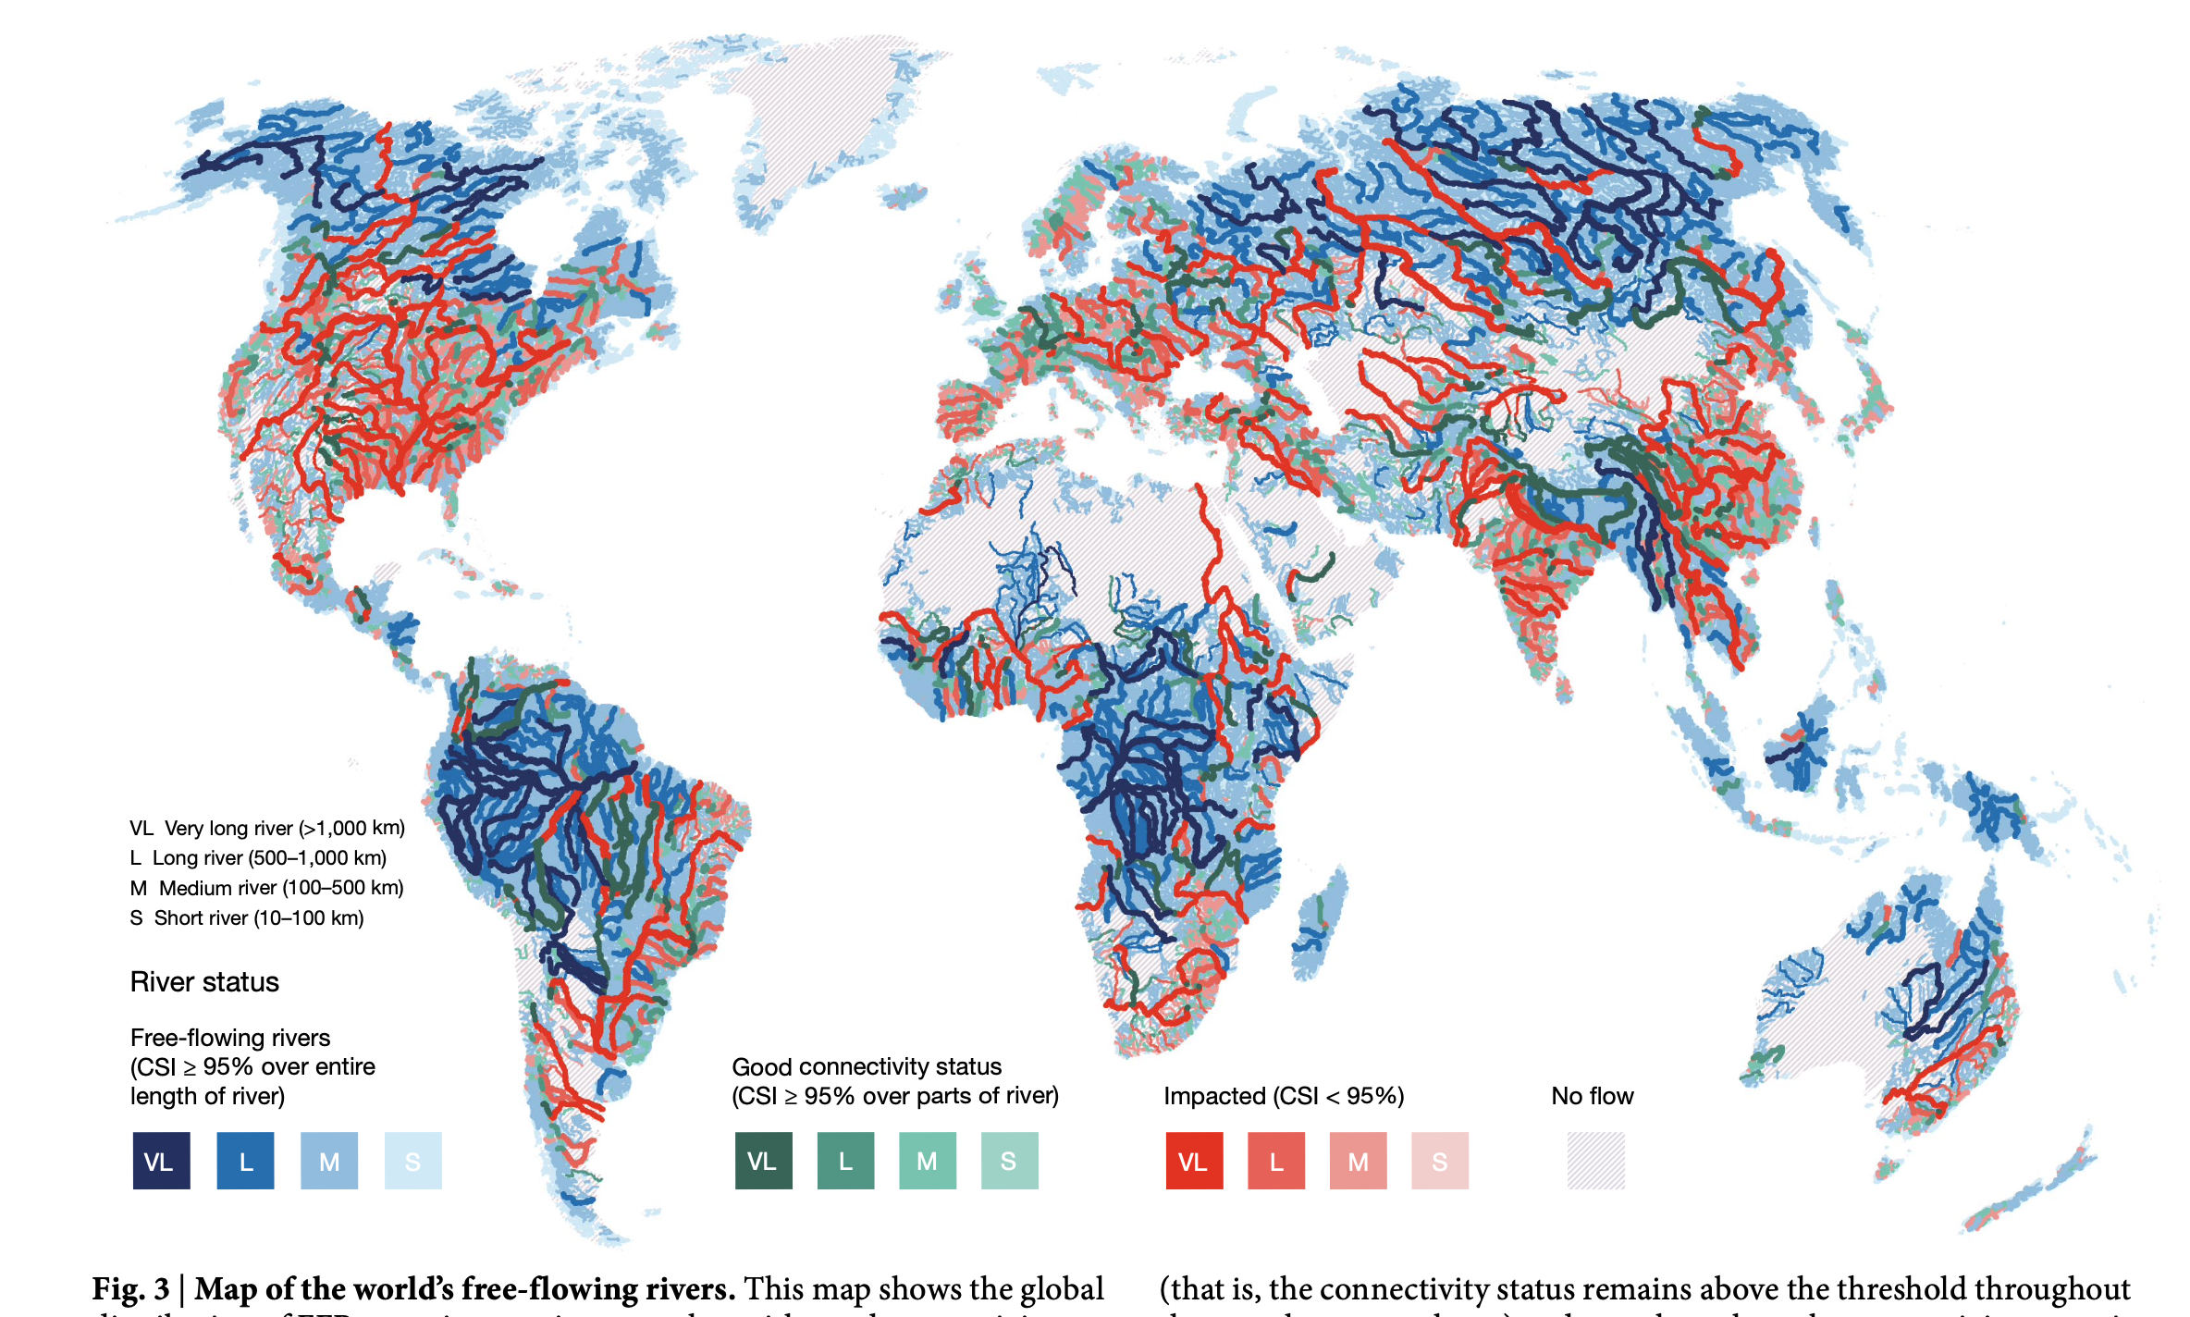
Mapping the world’s free-flowing rivers Grill, G., Lehner, B., Thieme, M. et al. Mapping the world’s free-flowing rivers. Nature 569, 215–221 (2019). https://doi.org/10.1038/s41586-019-1111-9
October 9th 2024
Ambre De Herde
Thilo Palomeras
Julia Schmidt
Aude Lecrivain

Slide 2
Table of contents
Methodology
Results
Discussion
Introduction

Slide 3
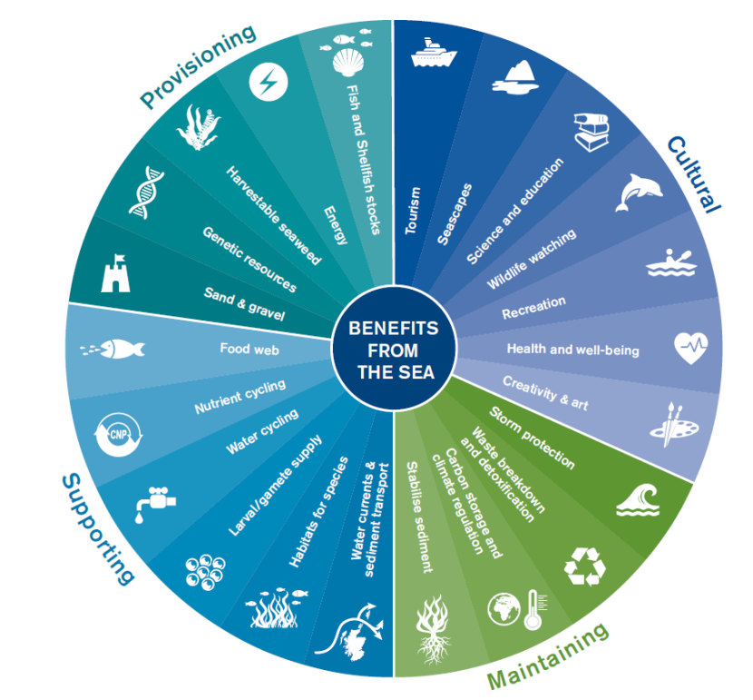
Introduction
Rivers provide ecological services
Built infrastructures facilitate providing goods and services
3,700 hydropower dams (>1 MW) are currently planned or under construction worldwide (2019)
Rivers sustain pressure from fragmentation → decline of biodiversity and essential ecosystems services
UN Sustainable Development Goal (SDG) n°6.6: Protect and restore water-related ecosystems
Fig. A: NatureScot – Ecosystem services
Notes:
Built infrastructure needed
Pressure-> affecting processes and functions: give example
Difficult to quantify the value of services provided by FFRs

Slide 4
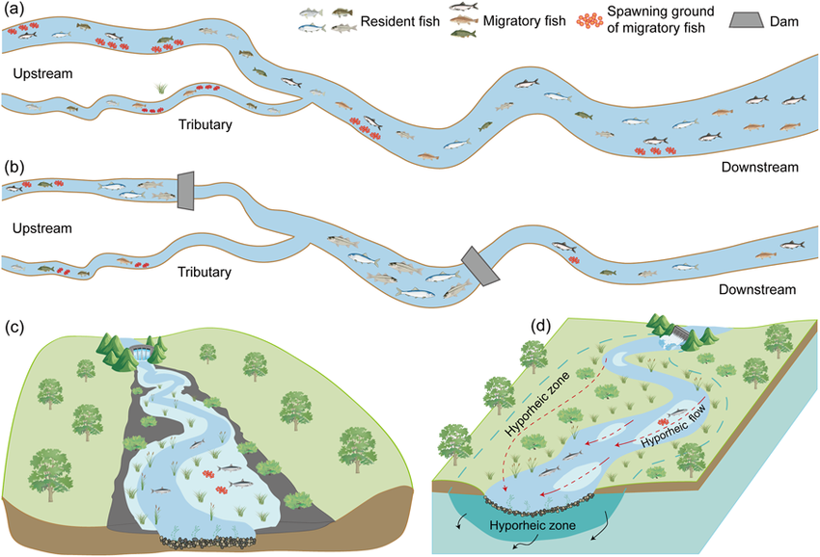
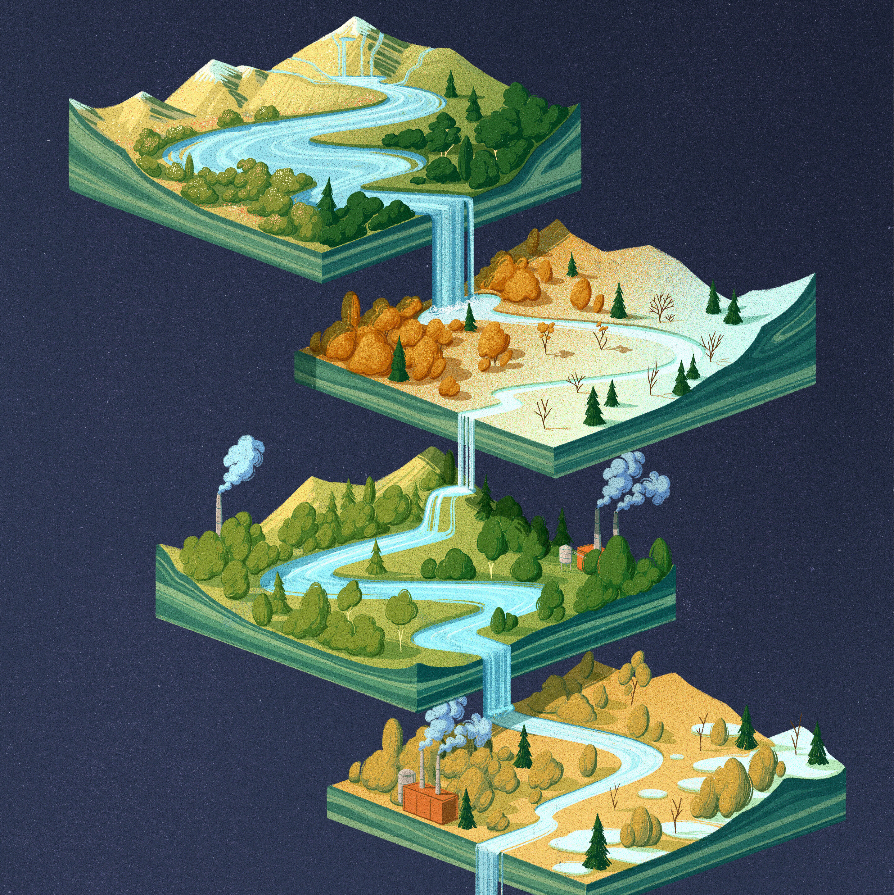
Introduction: 4 dimensions of connectivity
1) Longitudinal (along flow)
2) Lateral (through riparian zone)
3) Vertical (with groundwater and atmosphere)
4) Temporal
Fig B (a, c, d): River Damming Impacts on Fish Habitat and Associated Conservation Measures, Chen et al.
Fig C: Study shows climate change disrupts seasonal flow of rivers
Notes:
Explain 4 dimensions
These are all dynamic

Slide 5
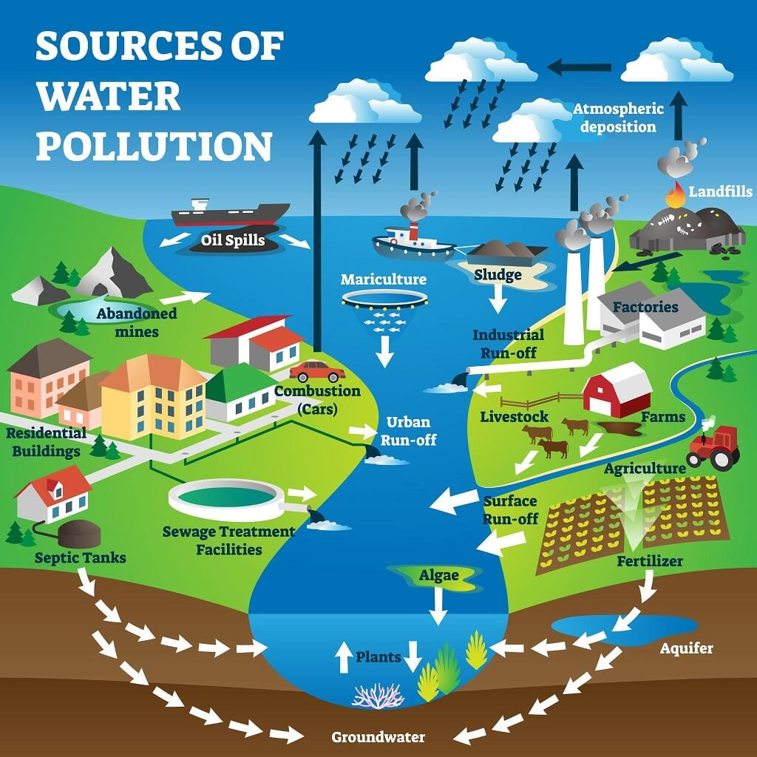
Introduction: Altered connectivity
Fig B (b): River Damming Impacts on Fish Habitat and Associated Conservation Measures, Chen et al.
Physical infrastructure in the river channel, along riparian zones or in adjacent floodplains
Hydrological alterations of river flow (abstractions or regulation)
Changes to water quality (pollution or temperature alterations) → ecological barrier effects
Fig D: What is water pollution? Conscious water Canada

Slide 6
Introduction
Assessing the current state and monitoring future trends is essential for the conservation and restoration of FFRs:
Before: coarse spatial scale data or proxys for dam impact
Recently: improved hydrological data (accessibility and resolution) → First high-resolution replicable assessment of FFRs
New definition of FFRs: based on an integrated connectivity status index (CSI)

Slide 7
Table of contents
Methodology
Results
Discussion
Introduction

Slide 8
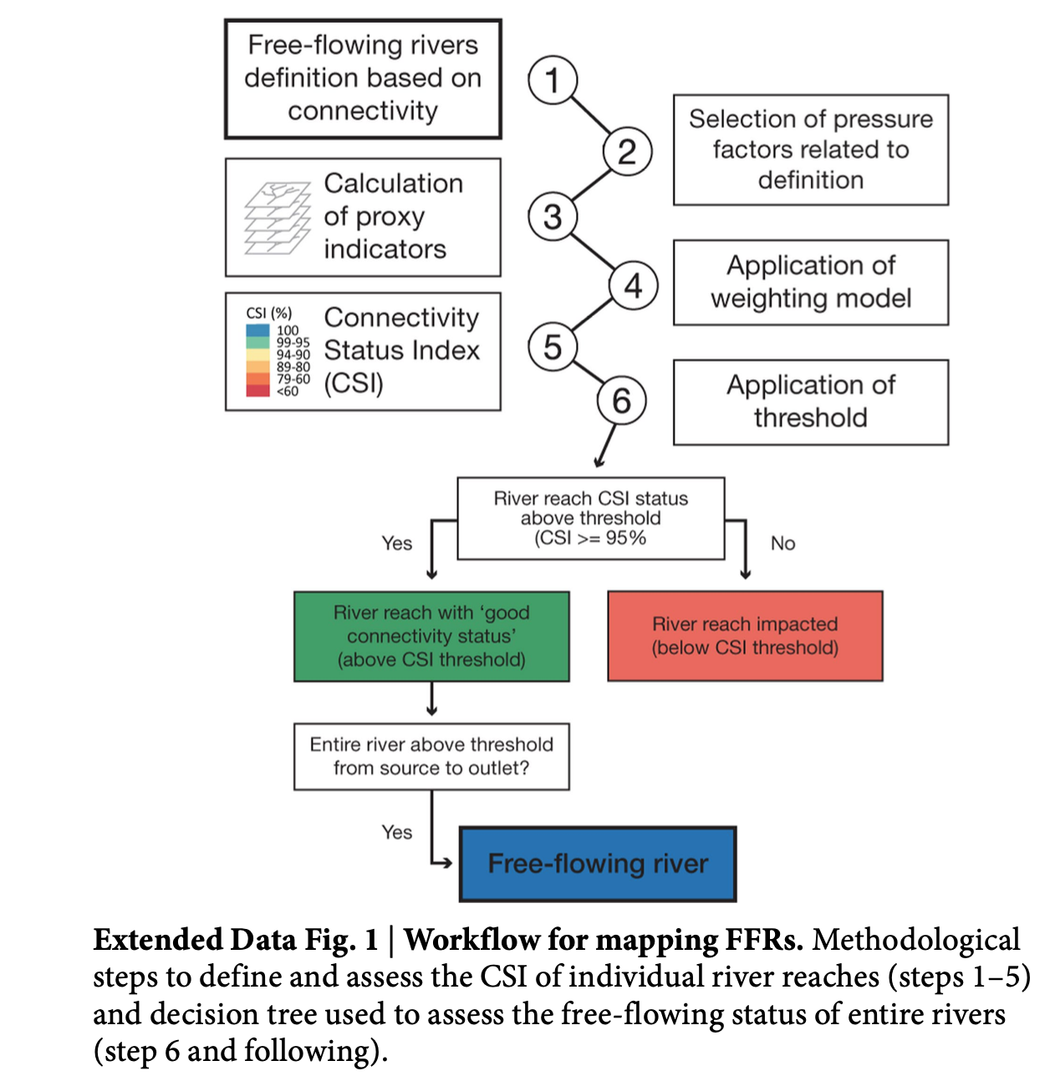
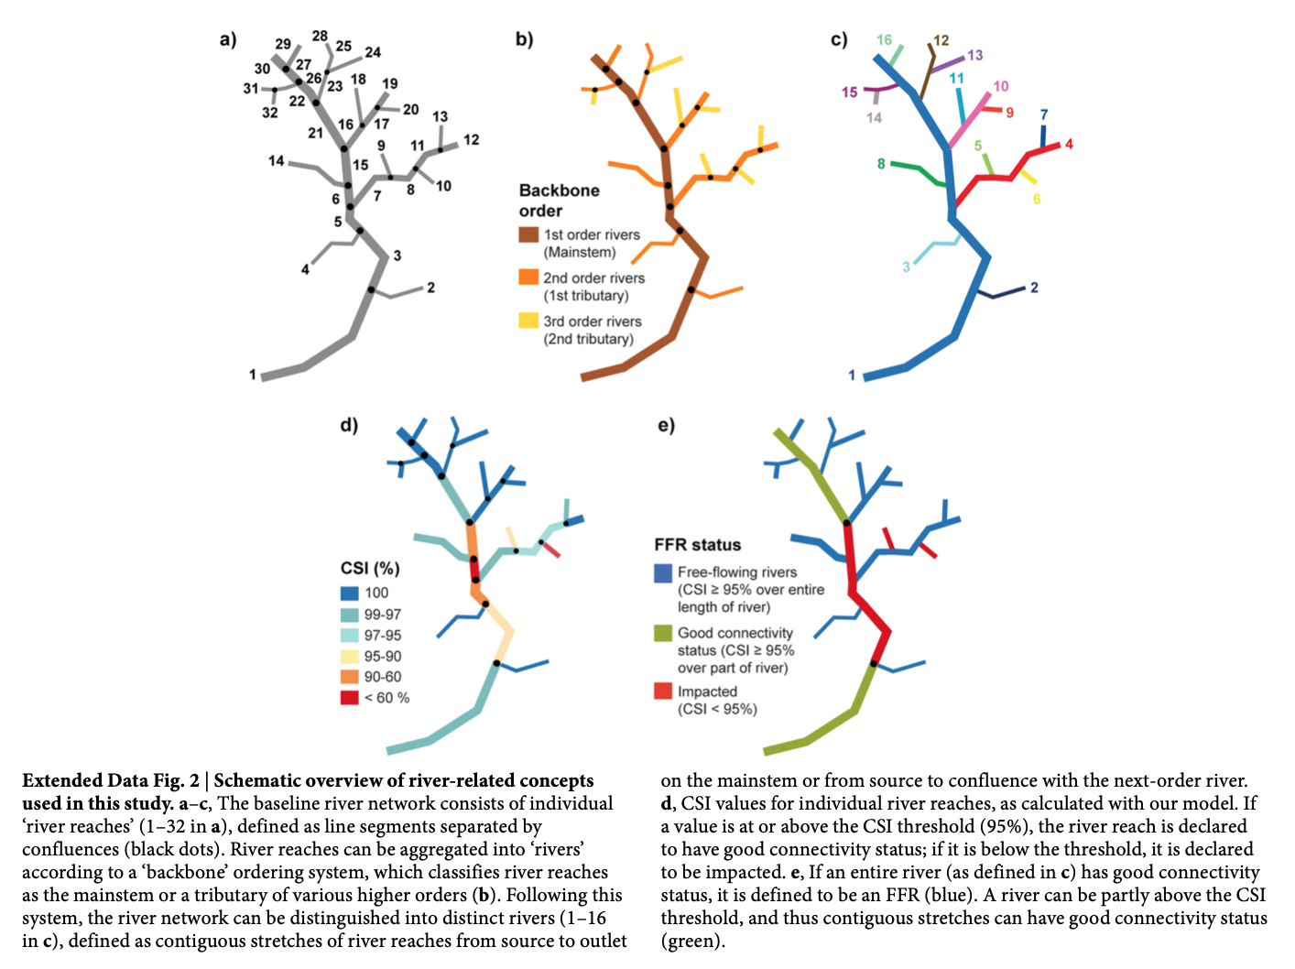
Methodology
Example of expected result
Notes:
3 years, with the participation of over 30 scientists, conservation practitioners and industry representatives
This methodology is devided in 6 steps to end up in the form of maps representing free flowing rivers

Slide 9
Methodology
Connectivity Status Indicator (CSI) of individual river reaches
Free-flowing status of entire rivers
Notes:
It is being done at 2 different scales: first at the reach level that is the river length between confluences
Second at the entire river scale: defined as contiguous stretches of river reaches from source to outlet on the mainstem or from source to confluence with the next-order river.

Slide 10
Methodology
Connectivity Status Indicator (CSI) of individual river reaches
Free-flowing status of entire rivers
Notes:
Let’s focus on the river reach scale

Slide 11
Methodology
Connectivity Status Indicator (CSI) of individual river reaches
Pressure factors
river fragmentation
flow regulation
sediment trapping
water consumption (surface or groundwater abstractions)
infrastructure development
2
Notes:
infrastructure development (riparian and floodplain areas)
1 st step is to define what is a free flowing river based on connectivity. This is based on the steps that actually follow
The point 2 consists of establishing 5 pressure factors that will be studied at the reach scale to evaluate how impacted it is

Slide 12
Methodology
Connectivity Status Indicator (CSI) of individual river reaches
Pressure factors
river fragmentation
flow regulation
sediment trapping
water consumption (surface or groundwater abstractions)
infrastructure development
Proxy indicators
DOF
DOR
SED
USE
RDD & URB
3
Notes:
3 : to quantify pressure factors, proxy indicators have been defined and quantified from data coming from remote sensing, other data compilation and numerical outputs

Slide 13
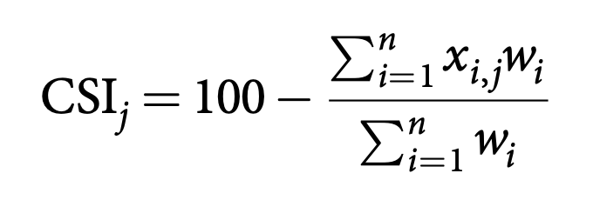
Methodology
5
Connectivity Status Indicator (CSI) of individual river reaches
Pressure factors
river fragmentation
flow regulation
sediment trapping
water consumption (surface or groundwater abstractions)
infrastructure development
Proxy indicators
DOF
DOR
SED
USE
RDD & URB
4
Weighting model
Notes:
4 these factors have been weighted to find the best match between the resulting FFRs and a benchmarking dataset of reported FFRs compiled from literature resources and expert input.
6 If a value is at or above the CSI threshold (95%), the river reach is declared to have good connectivity status; if it is below the threshold, it is declared to be impacted.

Slide 14
Methodology
Free-flowing status of entire rivers
Notes:
If an entire river has good connectivity status, it is defined to be an FFR (blue). A river can be partly above the CSI threshold, and thus contiguous stretches can have good connectivity status (green).

Slide 15
Table of contents
Methodology
Results
Discussion
Introduction

Slide 16
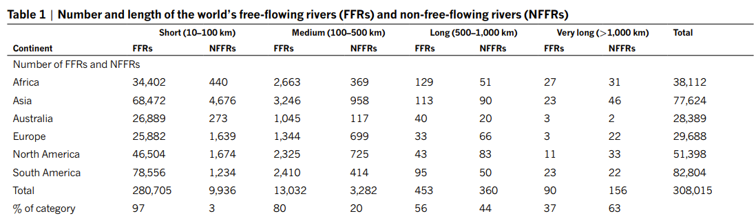
Results: FFRs, where and how much ?

Slide 17
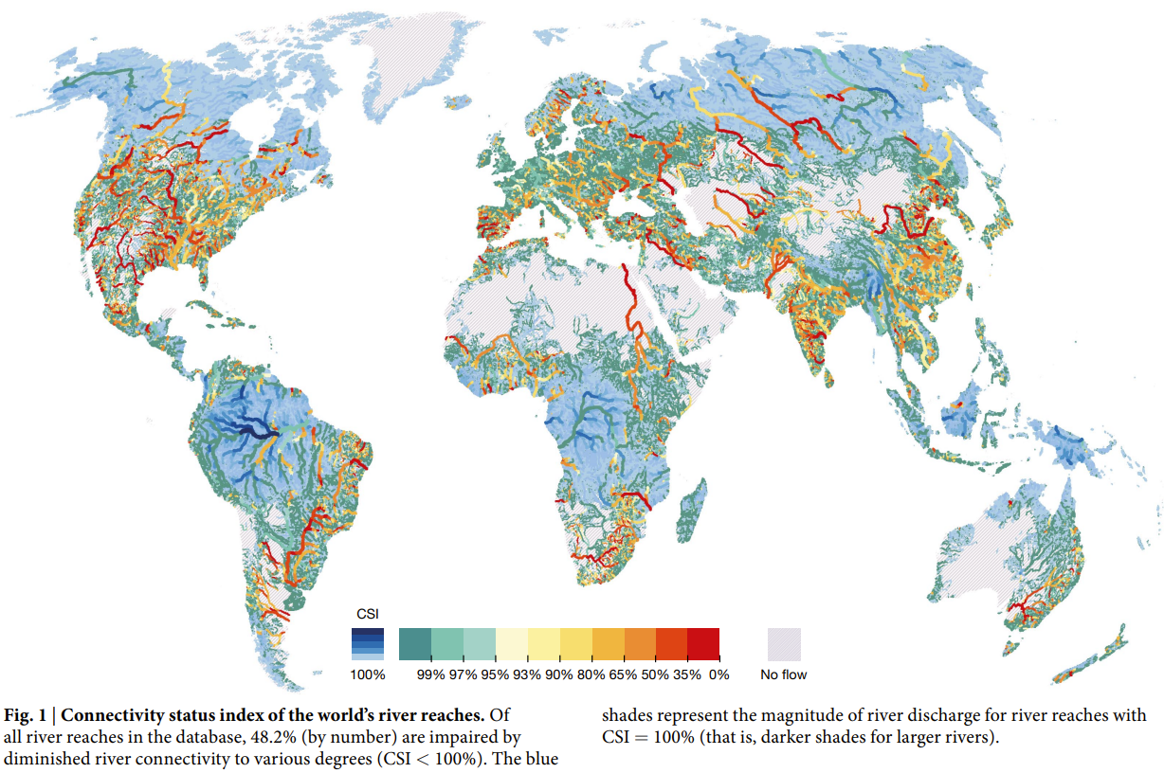
Results

Slide 18
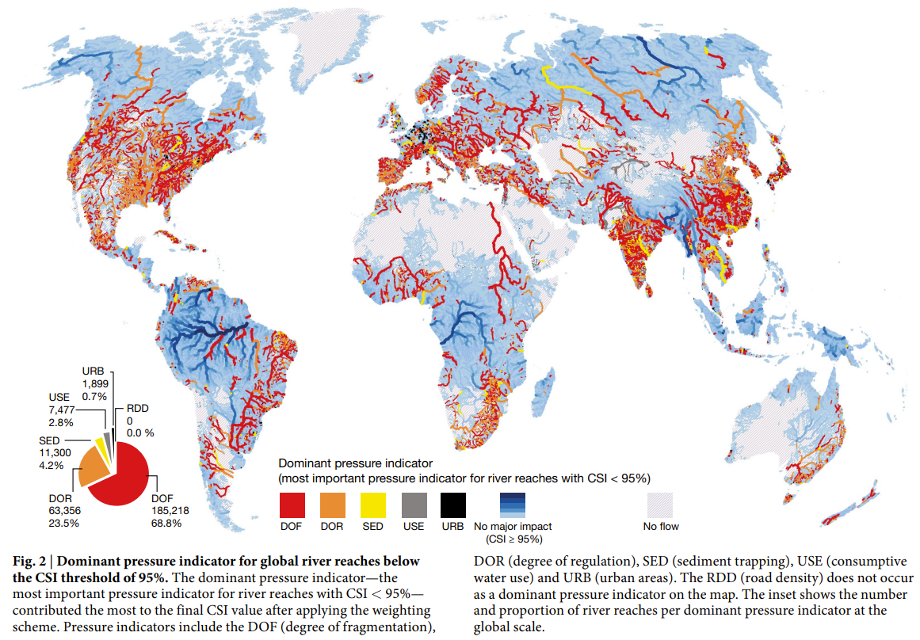
Results

Slide 19
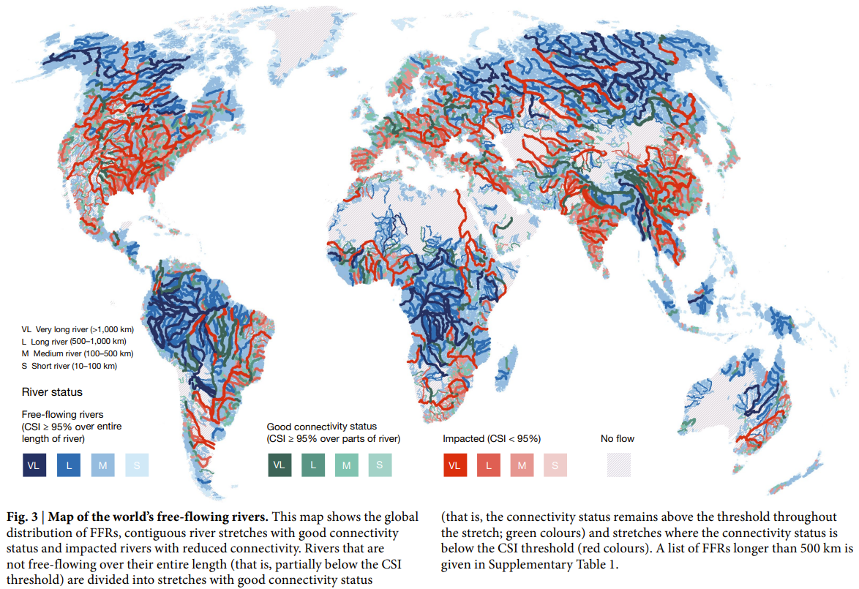
Results

Slide 20
Key results
About half of all river reaches globally show diminished connectivity (CSI < 100%; Fig. 1)
Almost 10% of analysed global river reaches (more than 1.1 million kilometres) have a CSI value below 95%, indicating major losses of connectivity
Dams and reservoirs and their up- and downstream propagation of fragmentation and flow regulation are the leading contributors to major connectivity loss in global river reaches (Fig. 2)
Among non-FFRs worldwide, a total of 542,000 km of river reaches can be classified as having a ‘good connectivity status’ (CSI ≥ 95%)

Slide 21
Table of contents
Methodology
Results
Discussion
Introduction

Slide 22
Discussion
Lack of georeferenced data of small dams, barrriers etc. « false positive rivers »
Global methodology is robust for long rivers but careful interpretation of the reusults at smaller scales unless additional data available
CSI and FFR takes into account river connectivity as component of ecosystem health. Other components not included (water quality, land use, invasive species etc.)
Of special concern is the loss of connectivity of very long and long rivers to the sea. They are of vital importance for the exchange of water, nutrients, sediments and species with deltas, estuaries and the ocea.
The global dataset and mapping tools developed are seen as valuable resources for governments and NGOs. These tools provide insights into where :
Rivers have high conservation values for protection,
Trade-offs between hydropower planning and river functions,
Underscore potential for restoration.
Finer resolution or higher quality data needed for better results and understanding
Notes:
Limits: countless small dams -> underscores need for governments and global institutions to georeference water infrastructure
Sensitivity analysis showed good for long rivers but carefule with short ones
Loss very long and long rivers to sea: remaining long FFRs deliver disproportionately high levels of certain ecosystem services, most notably inland and floodplain fisheries, sediment transport and biodiversity18,19,24. For example, the last two remaining very long FFRs in Southeast Asia—the Irrawaddy and Salween rivers—are critical sources of protein from inland fisheries, providing more than 1.2 million tonnes of catch annually39, and their flow regimes maintain extensive floodplain agriculture in a region inhabited by more than 30 million people.
Improved infrastructure planning to minimize ecological damage. Future development should integrate more sustainable practices, including environmental impact assessments (take into account f.e climate change, droughts.. irrigation) and the consideration of alternative energy solutions. The authors note that infrastructure like dams and reservoirs should be carefully planned, especially in regions where rivers are still largely free-flowing, to avoid further loss of ecological integrity.
Protecting the remaining FFRs should be a global conservation priority, according to the authors. They advocate for the implementation of river-specific conservation strategies that align with broader environmental goals, such as those outlined in the Convention on Biological Diversity and the Sustainable Development Goals (SDGs). The paper underscores the potential for river restoration, particularly in areas where aging dams and infrastructure can be decommissioned. Removing unnecessary barriers could help re-establish connectivity in fragmented rivers.
Fragmentation has profound ecological consequences, affecting species migration, sediment transport, and nutrient cycling. These processes are essential for maintaining biodiversity and ecosystem services.

Slide 23
Conclusion
" Given the current status and future perspective, action is needed to protect or restore these threatened fluvial systems, which provide some of the most diverse and dynamic environments worldwide."
Notes:
Limits: countless small dams -> underscores need for governments and global institutions to georeference water infrastructure
Sensitivity analysis showed good for long rivers but carefule with short ones
Loss very long and long rivers to sea: remaining long FFRs deliver disproportionately high levels of certain ecosystem services, most notably inland and floodplain fisheries, sediment transport and biodiversity18,19,24. For example, the last two remaining very long FFRs in Southeast Asia—the Irrawaddy and Salween rivers—are critical sources of protein from inland fisheries, providing more than 1.2 million tonnes of catch annually39, and their flow regimes maintain extensive floodplain agriculture in a region inhabited by more than 30 million people.
Improved infrastructure planning to minimize ecological damage. Future development should integrate more sustainable practices, including environmental impact assessments (take into account f.e climate change, droughts.. irrigation) and the consideration of alternative energy solutions. The authors note that infrastructure like dams and reservoirs should be carefully planned, especially in regions where rivers are still largely free-flowing, to avoid further loss of ecological integrity.
Protecting the remaining FFRs should be a global conservation priority, according to the authors. They advocate for the implementation of river-specific conservation strategies that align with broader environmental goals, such as those outlined in the Convention on Biological Diversity and the Sustainable Development Goals (SDGs). The paper underscores the potential for river restoration, particularly in areas where aging dams and infrastructure can be decommissioned. Removing unnecessary barriers could help re-establish connectivity in fragmented rivers.
Fragmentation has profound ecological consequences, affecting species migration, sediment transport, and nutrient cycling. These processes are essential for maintaining biodiversity and ecosystem services.

Slide 24
Questions ?

Slide 25
References
Paper: Grill, G., Lehner, B., Thieme, M. et al. Mapping the world’s free-flowing rivers. Nature 569, 215–221 (2019). https://doi.org/10.1038/s41586-019-1111-9
Fig. A: NatureScot – Ecosystem services
Fig. B (a, b, c, d): Chen, Q., Li, Q., Lin, Y., Zhang, J., Xia, J., Ni, J., et al. (2023). River damming impacts on fish habitat and associated conservation measures. Reviews of Geophysics, 61, e2023RG000819. https://doi.org/10.1029/2023RG000819
Fig. C: University of Leeds, Study shows climate change disrupts seasonal flow of rivers (2024). Phys.org. Image credits: Myriam Wares
Fig D: What is water pollution? Conscious water Canada https://consciouswater.ca/what-is-water-pollution/
Notes:
Limits: countless small dams -> underscores need for governments and global institutions to georeference water infrastructure
Sensitivity analysis showed good for long rivers but carefule with short ones
Loss very long and long rivers to sea: remaining long FFRs deliver disproportionately high levels of certain ecosystem services, most notably inland and floodplain fisheries, sediment transport and biodiversity18,19,24. For example, the last two remaining very long FFRs in Southeast Asia—the Irrawaddy and Salween rivers—are critical sources of protein from inland fisheries, providing more than 1.2 million tonnes of catch annually39, and their flow regimes maintain extensive floodplain agriculture in a region inhabited by more than 30 million people.
Improved infrastructure planning to minimize ecological damage. Future development should integrate more sustainable practices, including environmental impact assessments (take into account f.e climate change, droughts.. irrigation) and the consideration of alternative energy solutions. The authors note that infrastructure like dams and reservoirs should be carefully planned, especially in regions where rivers are still largely free-flowing, to avoid further loss of ecological integrity.
Protecting the remaining FFRs should be a global conservation priority, according to the authors. They advocate for the implementation of river-specific conservation strategies that align with broader environmental goals, such as those outlined in the Convention on Biological Diversity and the Sustainable Development Goals (SDGs). The paper underscores the potential for river restoration, particularly in areas where aging dams and infrastructure can be decommissioned. Removing unnecessary barriers could help re-establish connectivity in fragmented rivers.
Fragmentation has profound ecological consequences, affecting species migration, sediment transport, and nutrient cycling. These processes are essential for maintaining biodiversity and ecosystem services.

